Slide 1
Wow Assembly:
Friday 26th February

Slide 2
Green Cards!
Alfie S – Chestnut
Jimi C - Redwood

Slide 3
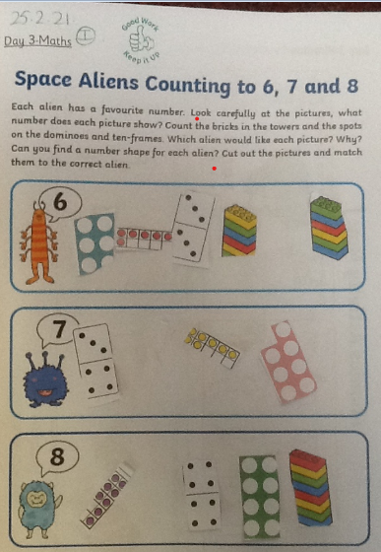
Reception in School
Taylor S
Super maths learning.
Mrs Laffan 26.2.2021

Slide 4
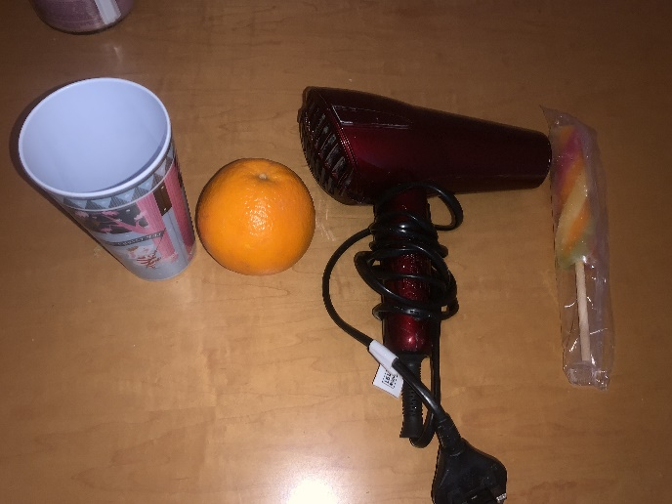
Reception home
Codi-Lee
Scavenger Hunt of objects for his name,
Mrs Laffan 26/02 /21

Slide 5
Birch bubble School
Sid
You have been trying so hard in maths. You have applied your knowledge to answer questions based on fractions. Your confidence has improved so much. Well done Sid!
Miss Hewitt 26 /02/21

Slide 6
Birch home
Ruby D
Well done Ruby for persevering through a difficult week. You have shown resilience and determination. I can’t wait to see what you can achieve when you are back in school. Well done ☺
Miss Hewitt 26/02 /21

Slide 7
Pine bubble School
Lucas P
An super return to school with a great attitude and AMAZING handwriting! Well done Lucas, keep it up!
Miss Brady 26/02 /21

Slide 8
Pine home
Freddie H
For a super attitude to learning and completing his daily quizzes every day. Thank you for sending me all your work.
Mrs Leedham-Hawkes 26/02 /21

Slide 9
Elm home
Felicity R
Felicity has worked incredibly hard in all that she does at home, and I am so proud! Over lockdown, I have received lots of amazing work. Well done Fliss!
Miss Brady 26 /02 /21

Slide 10
Willow Bubble at School
Jake
For
Settling back into school brilliantly and having a great attitude for learning for our new topic.
Well done.
Mrs Read and Miss Higgins 26.2.2021

Slide 11
Spruce
Home Learner
Ellie- Mae
For her fantastic enthusiasm when recording an advertisement for a new chocolate bar. Well done Ellie.
Miss Dawson 26.02.2021

Slide 12
Maple
Home Learner
Jack
For completing all home learning and trying really hard to improve his handwriting. Well done Jack
Miss Dawson 26.02.2021

Slide 13
Spruce School
Frankie
For a fantastic attitude towards his learning. Listening carefully in class and completing activities independently.
Miss Dawson 26.02.2021

Slide 14
Chestnut remote
wow learner
Jake M
For working extremely hard and always doing his best in his quizzes.
Mrs Davies 26.02.21

Slide 15
Aspen remote
wow learner
Frankie
For her continued superb learning attitude.
Mrs Davies 26.02.21

Slide 16
Aspen School
Wow Learner
Liam
For a positive attitude in the return to school and great contributions in PHSE.
Miss Fisher 26.02.2021

Slide 17
Redwood remote
wow learner
Lauren
For working extremely hard and always giving her quiz feedback 100%.
Mrs Davies 26.02.2021

Slide 18
Redwood school
WOW learner
Grace S
For having outstanding self awareness and really challenging herself this week, in all lessons
Miss Shipley 26.02.2021

