Slide 1
Wow Assembly:
Friday 29th January

Slide 2
Green Cards!
Kacey D - Willow
Phoebe C – Willow
Idris- Elm
Casper- Elm
Amber R – Spruce
Jaxson Y - Spruce

Slide 3
Reception in School
Daisy
For
Working independently in class and super reading.
Mrs Groves 29.1.2021

Slide 4
Reception home
Finley
For
Super number work, counting and ordering.
Mrs Laffan 29 /01 /21

Slide 5
Birch bubble School
Harri
For
Trying hard in his maths work. Harri is becoming much more confident when working with numbers and is making super links between learning.
Miss Hewitt 29 /01 /21

Slide 6
Birch home
Isabel P
For
Putting so much effort into her home learning. Isabel is acting on the feedback I am giving her and always challenges herself. She has written a fantastic Mary Anning fact file. Well done!
Miss Hewitt 29 /01 /21

Slide 7
Pine bubble School
Finley
For an amazing design of a planet and dinosaur to support his learning of ‘A Dinosaur that Pooped a Planet’.
Mrs Leedham-Hawkes 29 /01 /21

Slide 8
Pine home
Eli
For fantastic maths learning at home this week and using his own money jar.
Mrs Leedham-Hawkes 29 /01 /21

Slide 9
Elm home
Lucas P
For
Some amazing pieces of writing at home, with beautiful handwriting. Well done Lucas I can see how hard you are working, keep it up!
Miss Brady 29 /01 /21

Slide 10
Maple Home learner
Kade
For completing home learning booklets. Well done Kade!
Miss Dawson 29.01.2021

Slide 11
Willow Home
Scarlet
For lots of lovely learning every week and for a super Big Write at home using imperative verbs.
Mrs Read and Miss Higgins 29.01.2021

Slide 12
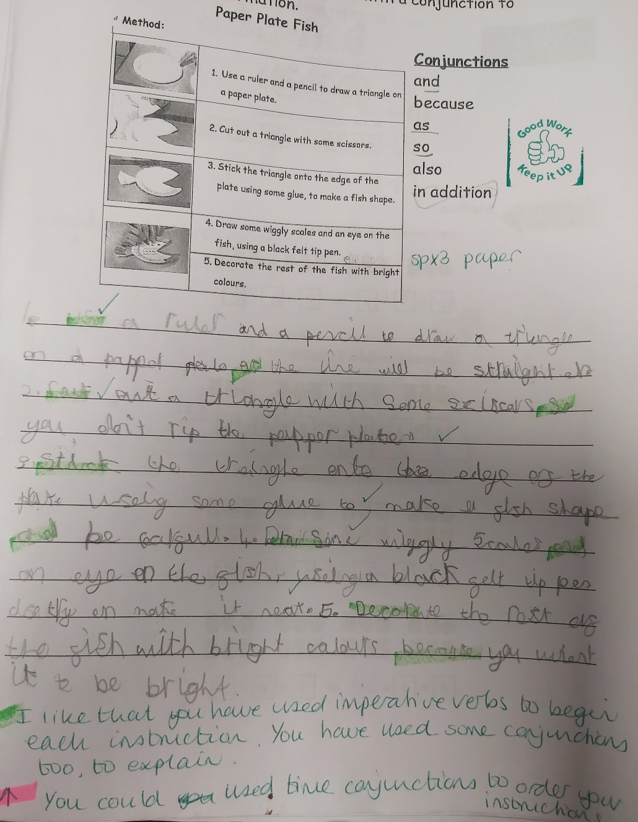
Willow Wow Work

Slide 13
Willow School
Violet
For creating facts and using ‘sensational’ vocabulary in your newspaper report.
Mrs Read and Miss Higgins 29.01.2021

Slide 14
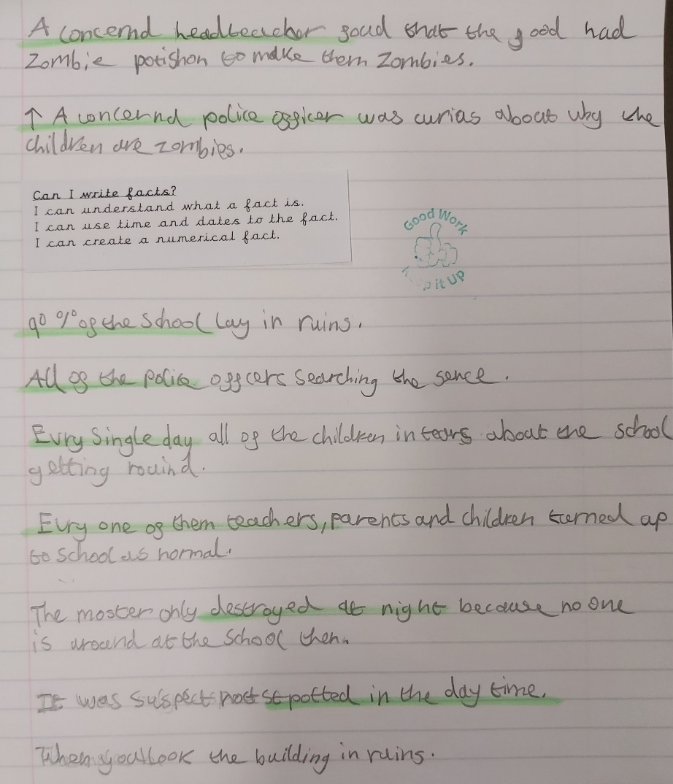
Willow Wow Work

Slide 15
Year 3/4
Home Learner
Kacey
For
Amazing work consistently during the week. Kacey writing has been absolutely brilliant going above and beyond what has been asked of her!
Mr Tennuci 29.01.2021

Slide 16
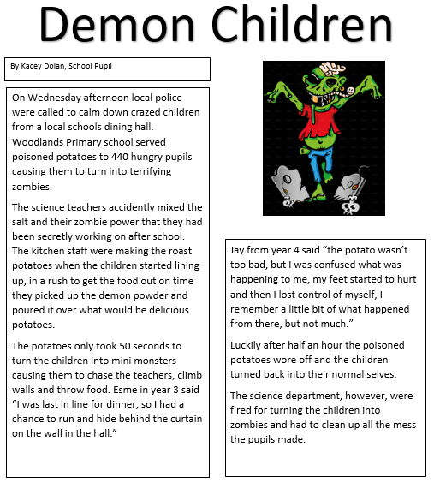
Year 3/4 Home Learner

Slide 17
Year 3/4
Home Learner
Phoebe C
For
Continually producing exceedingly brilliant work in many different subjects over the week, especially in art and English.
Mr Tennuci 29.01.2021

Slide 18
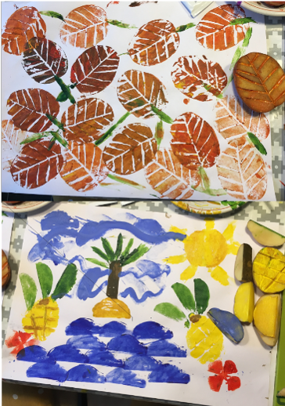
Year 3/4 Home Learner

Slide 19
Spruce School
Malakai
For showing a huge improvement in handwriting. Well done Malakai.
Miss Dawson 29.01.2021

Slide 20
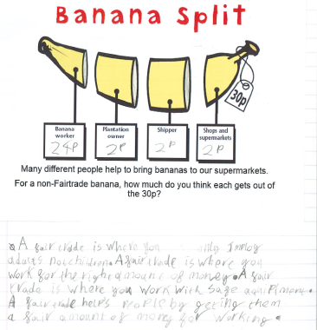
Spruce Wow Work

Slide 21
Chestnut remote
wow learner
Riley C
For his super attitude to home learning. Keep it up!
Mrs Davies 29.01.21

Slide 22
Aspen remote
wow learner
Milenka
For showing excellence and creativity when completing her snowman challenge; even making a snow dog!
Mrs Davies 29.01.21

Slide 23
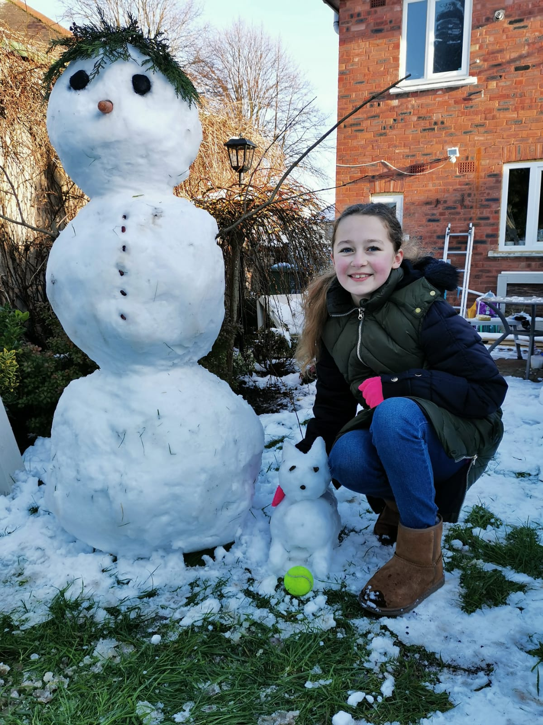

Slide 24
Aspen School
Wow Learner
Alfie S
For having a fantastic attitude towards all of his learning and always giving 100%
Miss Fisher 29.01.21

Slide 25
Redwood remote
wow learner
Charlie D
For his superb attitude to learning at home. Miss Shipley and I are so impressed!
Mrs Davies 29.01.21

Slide 26
Redwood school
WOW learner
Madison
For never giving up and being an excellent role model for the other children in class
Miss Shipley 29.01.21

