Slide 1
Wow Assembly:
Friday 19th March

Slide 2
Phrase of the Week:
Education is the most powerful weapon that you can use to change the world.

Slide 3
Green Cards!
Freddie-Oak
Jay – Willow
Millie – Willow
Tobias – Willow
Sophie – Spruce
Amber - Spruce

Slide 4
Scientists of the Week!
Oak –Callum
Ash – Alfie
Birch – Ella
Pine – Ava
Elm – Theo Y
Willow – Scarlet
Spruce – Ellie E.
Maple – Erin 4
Redwood – Molly
Chestnut - Robbie
Aspen- Emily

Slide 5
Weekly Team Points!
Peel | Ethelfleda | Grazier | Offa
132
109
110
52

Slide 6
Oak
Olivia
For
Changing the Humpty Dumpty Nursery rhyme in writing.
Mrs Laffan 18.03.21

Slide 7
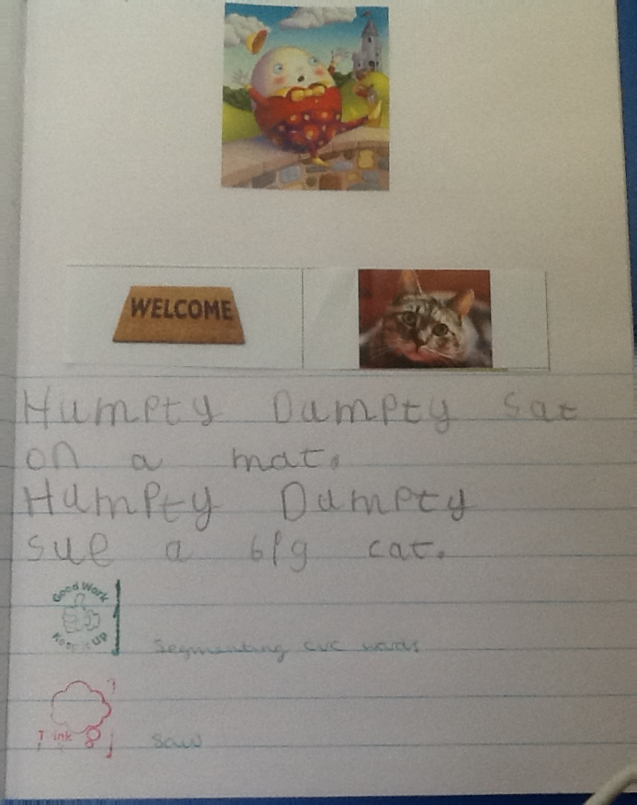
Oak Wow Work

Slide 8
Ash
Alfie C
For
Super science work-Alfie could identify and talk about the different types of materials.
Mrs Laffan 18.03.21

Slide 9
Elm
Ezmai H
For
A really super week of reading! Ezmai has been very fluent, used lots of expression and on many occasions used clues in the text to answer questions. Well done Ez! ☺
Miss Brady 18.03.21

Slide 10
Birch
Joshua. T
For his amazing reading. Joshua’s word reading has improved so much. He is becoming fluent and confident and his comprehension is improving too. Well Joshua! Your hard work is paying off ☺
Miss Hewitt 19.03.21

Slide 11
Pine
Callum
For following instructions to plant a seed and make bread linking to our learning of Hansel and Gretel this week. Well done ☺
Mrs Leedham-Hawkes 19/3/21

Slide 12
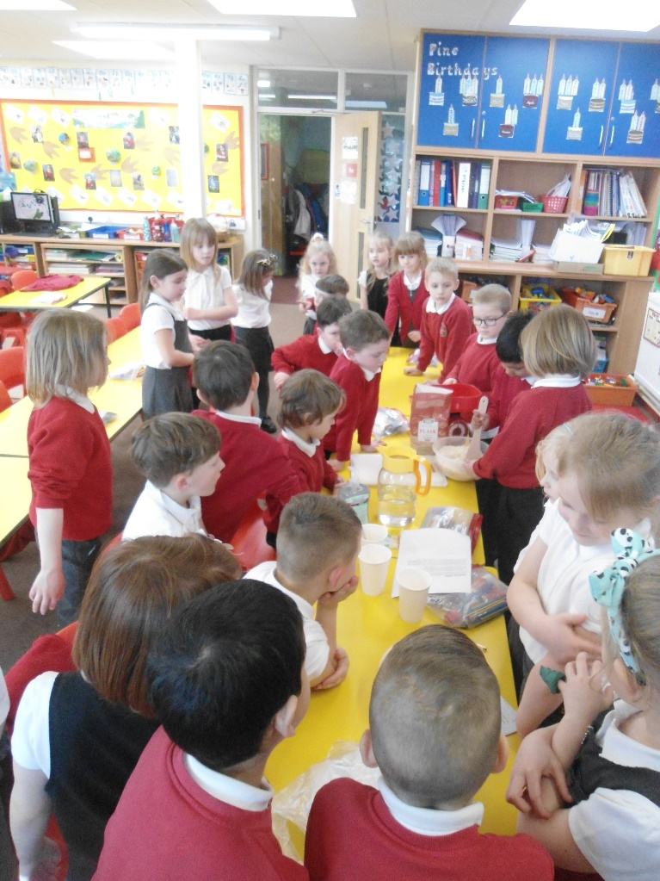
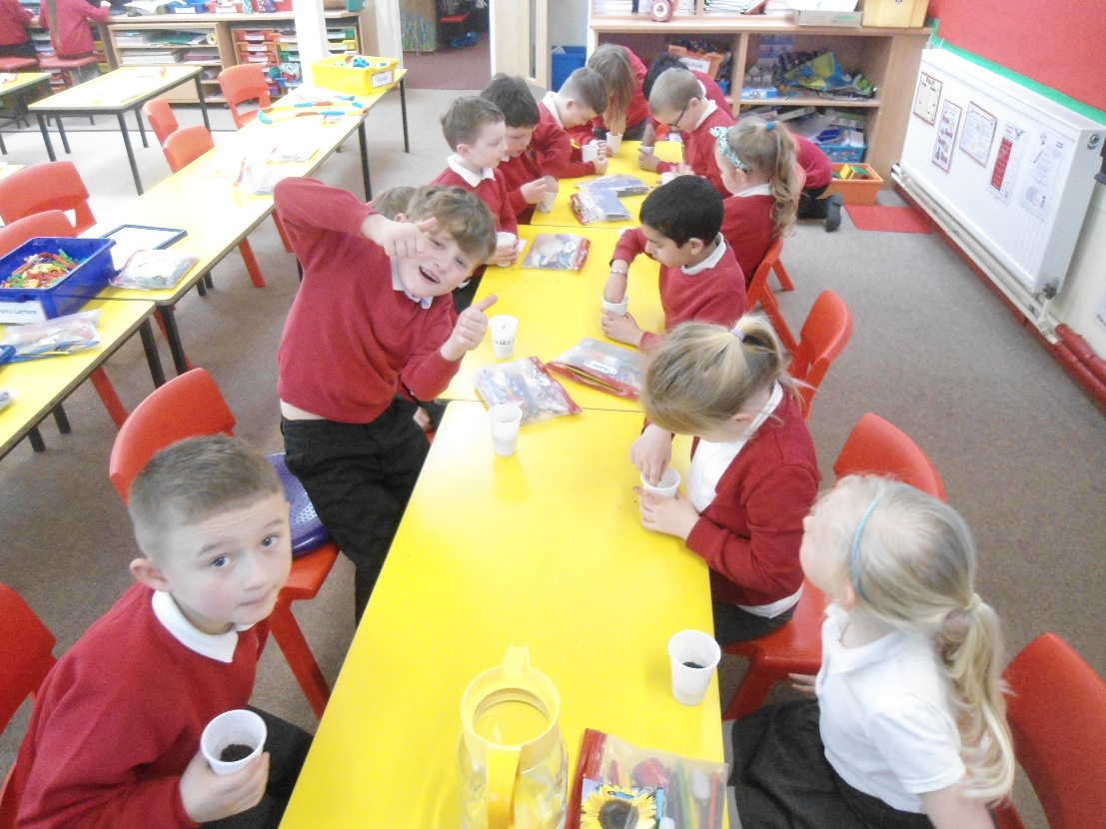
Pine Wow Work

Slide 13
Maple
Jessica Allen
For a fantastic sketch of a canopic jar.
Well done Jess!
Miss Dawson 18.03.2021

Slide 14
Maple Wow Work

Slide 15
Willow
Isabella M
For
Creating an amazing canopic jar out of clay, showing resilience to improve your work.
Mrs Read and Miss Higgins 18.3.2021.

Slide 16
WillowWow Work

Slide 17
Spruce
Philippa
For
Producing some wonderful writing about how ancient Egyptians were mummified, showing a great interest in this subject and her continued efforts to improve her letter formation.
Mr Tennuci 18.3.21

Slide 18
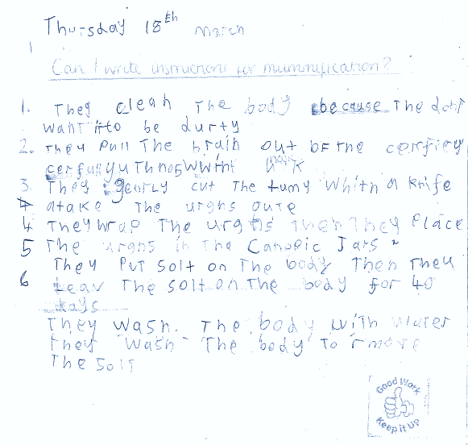
Spruce Wow Work

Slide 19
Chestnut
Amelia M
For fantastic communication during our PHSE Lesson. Amelia shared some wonderful ideas and gave plenty of justifications. Well Done Amelia.
Miss Fisher 19.03.21

Slide 20
Aspen
Eddie
For consistently showing passion and excellence in PE lessons.
Keep it up!
Mrs Davies 19.03.21

Slide 21
Aspen Wow Work

Slide 22
Redwood
Amy R.
For displaying wonderful self awareness, during assessment week, and maintaining a positive attitude throughout the whole week,
Miss Shipley 19.03.21

Slide 23
Redwood Wow Work

