Slide 1



Wow Assembly:
Friday 22nd January

Slide 2
Green Cards!
Sophie Knight – Willow
Riley Cracknell – Willow
Alfie-Ray Collins-Bradshaw – Willow
Charlie Sigley – Spruce
Eppie Samuel – Spruce
Lauren P. - Redwood

Slide 3
Reception in School
Austin
For
Super maths learning and trying hard to form numbers correctly.
Mrs Groves 22.1.2021

Slide 4
Reception home
Francesca
For
Completing all of the learning activities to a superstar standard and for the good progress in her handwriting.
Mrs Laffan 22 /01 /21

Slide 5
Birch bubble School
Cody S
For
Cody has really challenged himself in his learning this week-Particularly in his maths work. Keep up the hard work ☺
Miss Hewitt 22 /01 /21

Slide 6
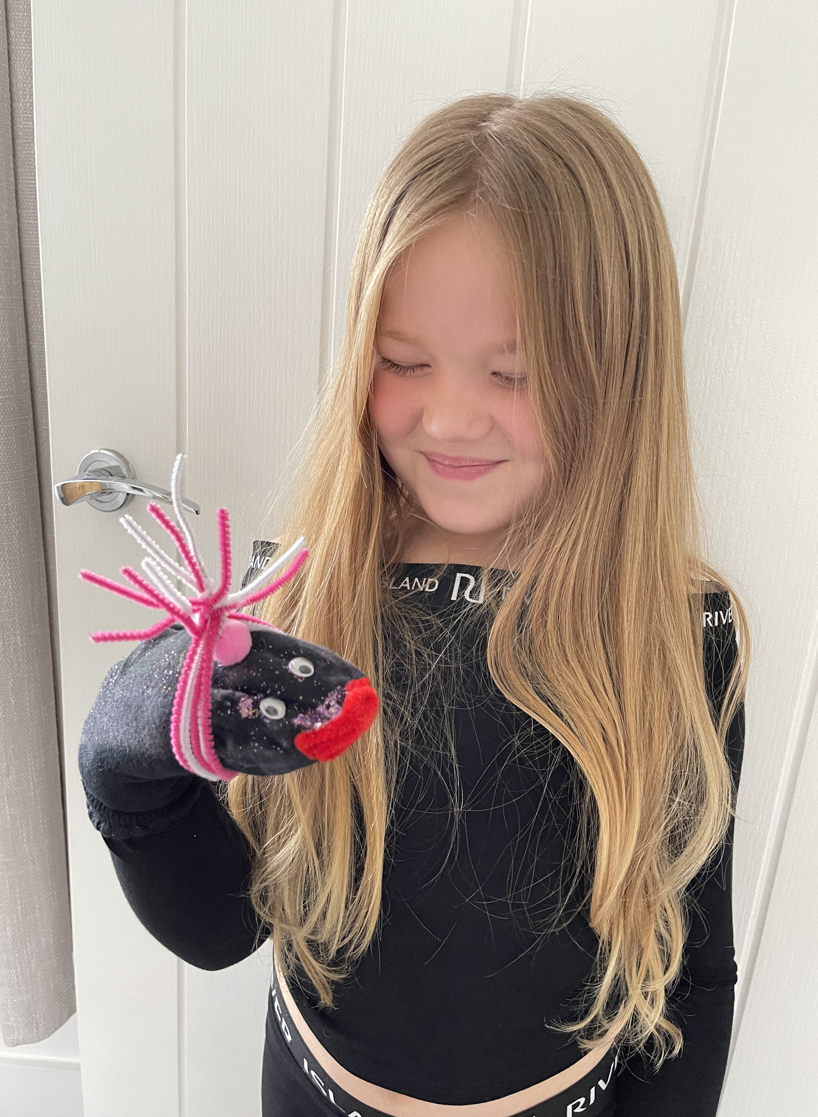
Birch home
Ruby A
For
A fantastic attitude to learning. Ruby has been working so hard at home. As well as completing all the class work, she has also completing further learning in areas she finds tricky. Very proud Ruby. Well Done!
Miss Hewitt 22 /01 /21

Slide 7
Pine bubble School
Ryan G
For
An amazing effort in all lessons and being super kind and helpful. Ryan listened carefully in maths and has shown lots of passion and resilience. Well done Ryan!
Miss Brady 22 /01 /21

Slide 8
Pine home
Seb
For using passion to create a fantastic Dinosaur
Sock Puppet in our DT lesson.
Mrs Leedham-Hawkes 22 /01 /21

Slide 9
Elm home
Tobias Y
For
Amazing effort with his home learning. Tobias has been completing all work set with enthusiasm and passion. I love hearing what you’ve been up to Tobi, keep it up!
Miss Brady 22 /01 /21

Slide 10
Maple Home learner
Jack
For writing a fantastic new chapter for ‘Charlie and the Chocolate Factory’. Jack included a range of conjunctions and commas in a list. Well done Jack!
Miss Dawson 22.01.2021

Slide 11
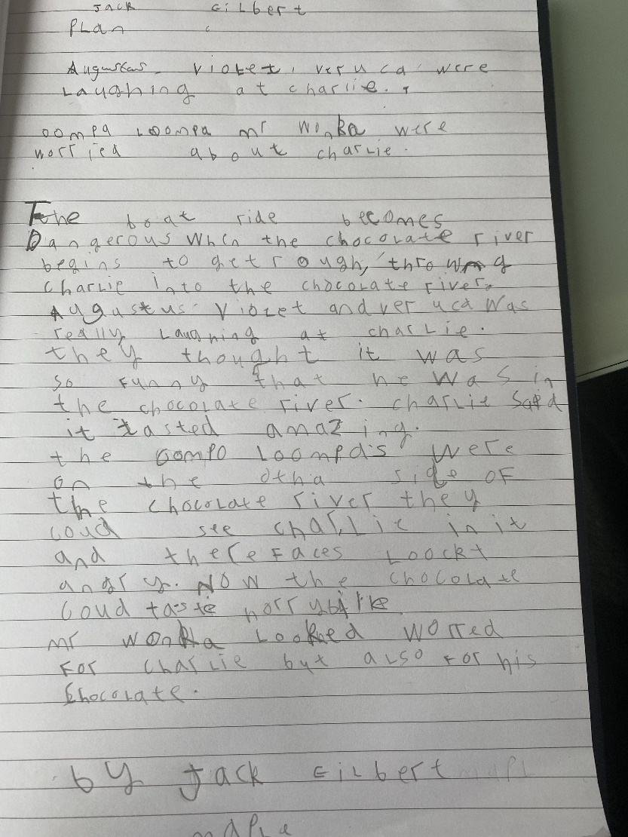
Maple Wow Work

Slide 12
Willow Home
Emma
For excellent use of adverbials and ‘show not tell’ in her Big Write at home.
Mrs Read and Miss Higgins 22.01.2021

Slide 13
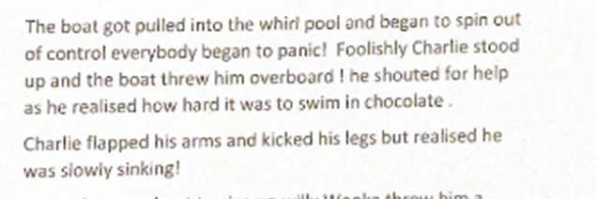
Willow Wow Work
Part of Emma’s wonderful new chapter to Charlie and the Chocolate Factory.

Slide 14
Willow School
Riley WP
For showing resilience and determination in his maths learning at school.
Mrs Read and Miss Higgins 22.01.2021

Slide 15
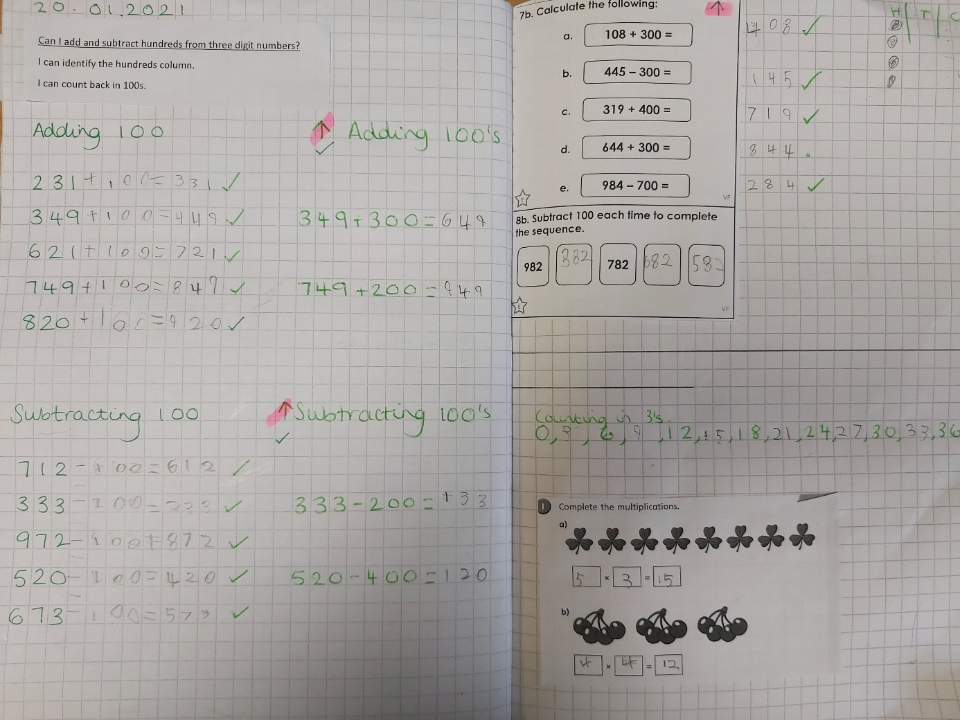
Willow Wow Work
Fabulous independent learning, Riley!

Slide 16
Year 3/4
Home Learner
Charlie Sigley
For
Amazing work across a range of different subjects.
Mr Tennuci 22.01.2021

Slide 17
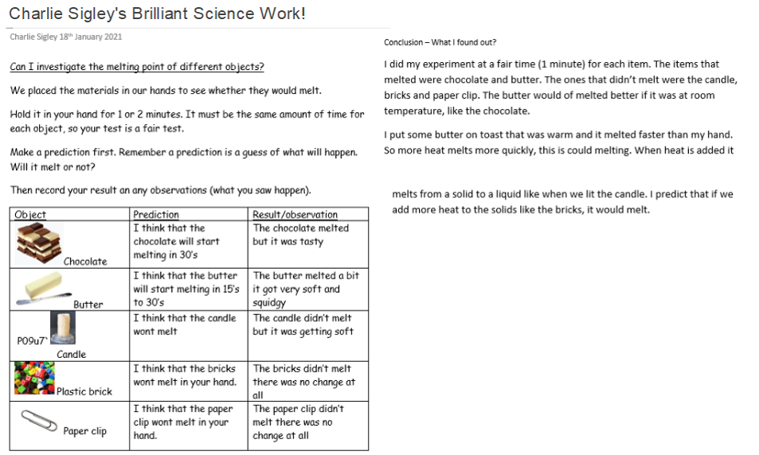
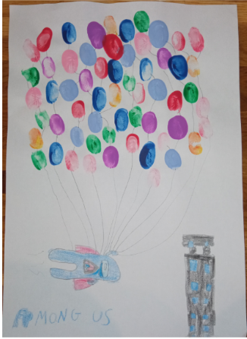
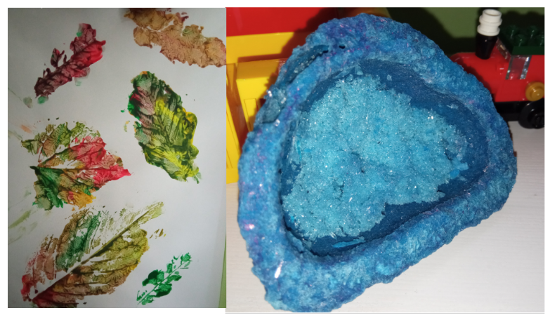
Year 3/4 Home Learner

Slide 18
Spruce School
Amelia S
For designing and creating a beautiful picture of a bowl of fruit using printing.
Miss Dawson 22.01.2021

Slide 19
Spruce Wow Work

Slide 20
Chestnut remote
wow learner
Karina
For her consistent super attitude to learning, even going above and beyond when completing her quizzes.
Keep it up!
Mrs Davies 22.01.21

Slide 21
Aspen remote
wow learner
Jayden
For his superb, positive attitude to learning. Jayden is even going further and challenging himself. Super!
Mrs Davies 22.01.21

Slide 22
Aspen School
Wow Learner
Jake
For his superb, questioning and discussion about Martin Luther King and the links that he made to Rosa Parks.
Miss Fisher 22.01.21

Slide 23
Redwood remote
wow learner
Aimee
For her superb, positive attitude to learning.
Keep it up!
Mrs Davies 22.01.21

Slide 24
Redwood school
WOW learner
Hollie
For her outstanding effort and determination during PE! Keep up the amazing work!
Miss Shipley 22.01.21

