Slide 2
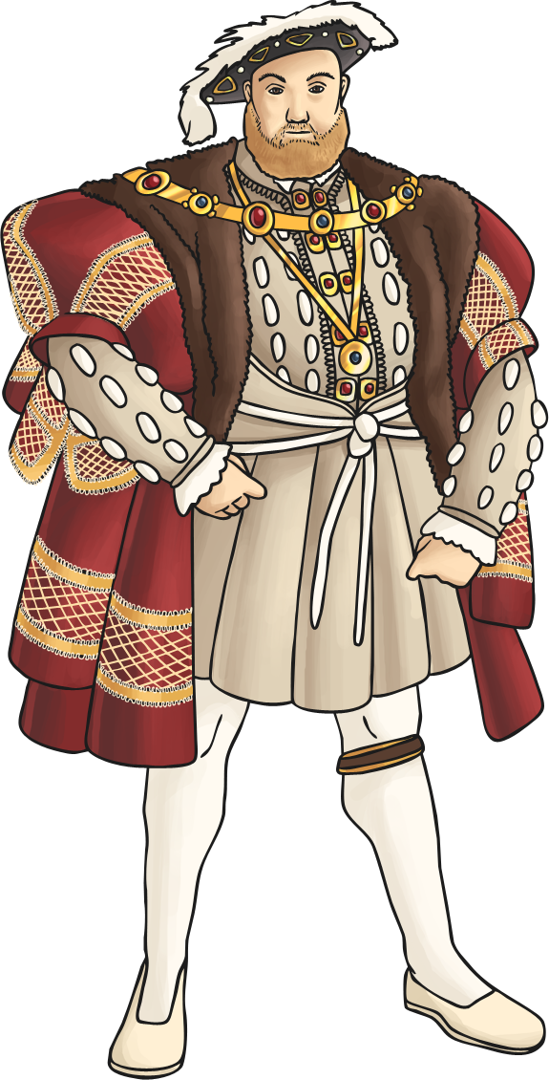
Who was Henry VIII?
Henry VIII is one of England’s most famous monarchs. He is part of the Tudor dynasty, the family that ruled England from 1485 to 1603.
Henry is famous for his furious temper, often executing those who angered him, and his love of feasting.
Perhaps most famously, he is remembered for having six wives.

Slide 3
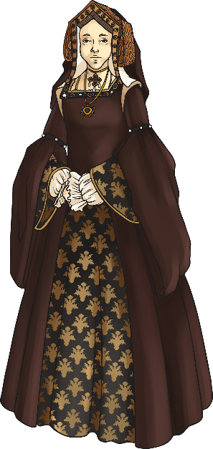
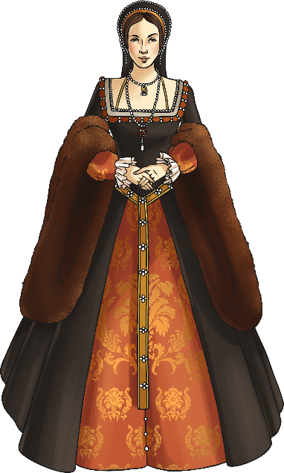
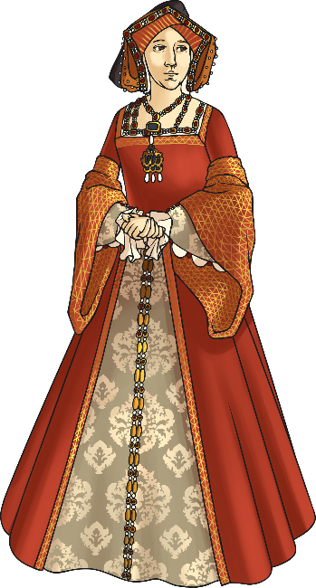
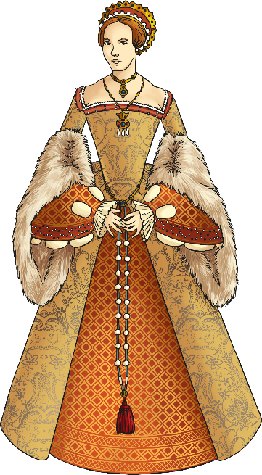
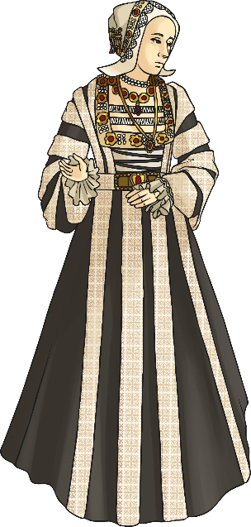
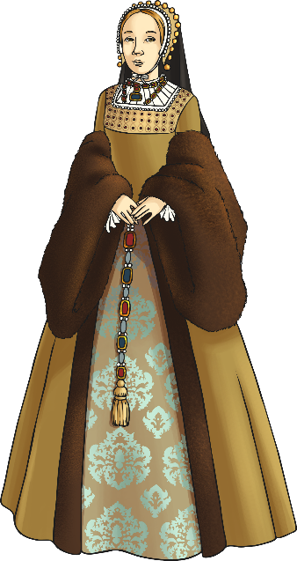
Henry’s Six Wives
Click on each wife for information about them.
Catherine of Aragon
1485 - 1536
Anne Boleyn
c.1501 - 1536
Jane Seymour
c.1508 - 1537
Anne of Cleves
1515 - 1557
Catherine Howard
c.1523 - 1542
Catherine Parr
c.1512 - 1548

Slide 4
Catherine of Aragon
After her marriage to Henry was declared void, Catherine retired to live a quiet life, spending most of her time in one room except when she went to pray.
She was forbidden from seeing her daughter, Mary, unless she accepted Anne as the new queen, which she refused to do.
In late 1535, Catherine’s health began to fail and on 7th January 1536, she died at the age of 50.
As divorce was not allowed in the Catholic church, Henry tried to get special permission from the Pope to annul his marriage. This became known as the King’s “Great Matter”.
The Pope refused him, angering Henry. In order to get his way, Henry decided to break England away from Rome and the Catholic church and instead created the Church of England, appointing himself head of the church.
In 1533, Henry’s marriage to Catherine was declared null and void and Henry was free to marry his second wife, Anne Boleyn.
Henry married his first wife, Catherine of Aragon, when he was 17 years old and she was 23 years old.
Catherine, a Spanish princess, had previously been married to Henry’s older brother, Arthur. After only a few months of marriage, Arthur fell ill and died.
When Henry became king in 1509, he decided to marry Catherine himself.
Throughout their marriage, Henry and Catherine had several children. Sadly, however, only one child survived past infancy; a daughter, Mary, who would later go on to become Queen of England in 1553.
Henry was desperate for a son and heir to carry on his legacy. As the years passed, Henry began to notice other women at court and, in 1525, fell in love with Anne Boleyn, one of Catherine’s ladies-in-waiting.
Henry decided that he wanted to divorce Catherine and marry Anne.
Back

Slide 5
Anne Boleyn
Anne was very skilled in the art of diplomacy. She had previously lived at French court and knew how to make friendships with important people.
As Henry’s queen, Anne was said to have had a lot of influence in the king’s opinions so many sought her approval.
Unusual for the time, Anne was very spirited and opinionated and often clashed with Henry when he felt she spoke out of turn.
In 1533, Anne gave birth to a daughter, Elizabeth, who would go on to become one of England’s most famous queens, Elizabeth I. Henry was disappointed but believed that as they were both young, sons would follow. Sadly for Anne, this was not to be the case and Henry began to tire of her.
In early 1536, Henry started to court Jane Seymour. Jane was moved into quarters near to the king which infuriated Anne.
On 2nd May 1536, Anne was arrested on charges of being unfaithful to the king. She was found guilty of treason and sentenced to death.
On 19th May, Anne was beheaded.
Back

Slide 6
Jane Seymour
Jane formed a close friendship with her stepdaughter Mary and tried hard to restore her relationship with her father.
Jane fell pregnant in January 1537 and Henry was delighted. In September, she gave birth to a son, Edward. Henry was overjoyed as he finally had the son and heir he had always desired.
Sadly, Henry’s joy turned to despair when Jane fell ill shortly after giving birth. She died from an infection on 24th October, devastating Henry.
Jane was buried in St George’s Chapel at Windsor Castle.
Jane was part of a noble family that lived in the north of England. She was given the role of lady-in-waiting to Anne Boleyn, which is where Henry first spotted her.
Jane and Henry became engaged the day after Anne’s execution, marrying on 30th May 1536.
Jane was said to be gentle-natured, peaceful and loving. She very rarely spoke to Henry about political matters and when she did, he warned her not to ‘meddle in his affairs’.
Back

Slide 7
Anne of Cleves
Two years after Jane’s death, Henry’s advisors persuaded him to marry again. Thomas Cromwell, the king’s chief minister, asked him to consider marrying Anne of Cleves, a German princess.
After receiving a portrait of Anne, Henry agreed to the marriage. Anne travelled to England in late 1539.
Henry couldn’t wait to meet Anne and travelled to meet her on New Year’s Day 1540. He was disappointed when he met her, complaining to Cromwell that she was nothing like her portrait and he didn’t like her.
Despite his protests, Henry and Anne were married on 6th January 1540.
Anne and Henry were only married for around 6 months. As Henry was so unhappy, he asked Anne for an annulment, which she agreed.
As a reward for not fighting the annulment, Anne was given lands and money to keep her comfortable for life. She was also referred to as the king’s ‘beloved sister’ and it was ordered that she be treated as the most important woman in England, except for his wife and daughters.
Anne stayed in England the rest of her life in comfort and died in 1557 at the age of 41.
Back

Slide 8
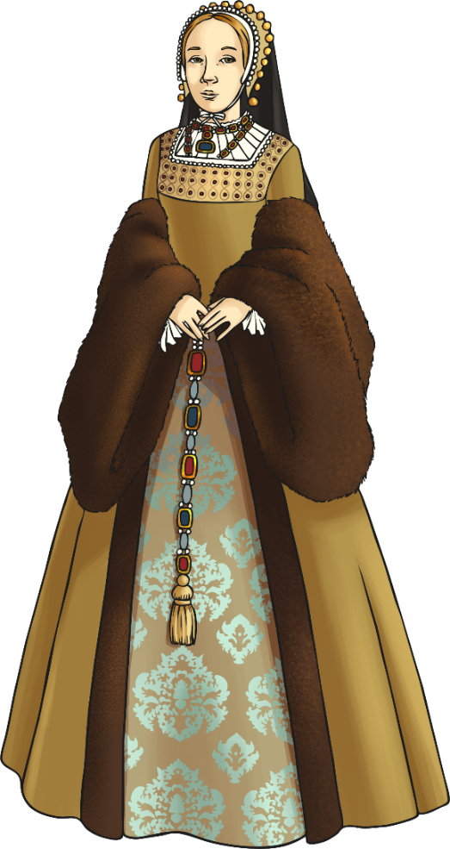
Catherine Howard
Catherine Howard came to court as a lady-in-waiting to Anne of Cleves and she quickly caught Henry’s eye.
On 28th July 1540, Henry and Catherine married. She was just 17 years old.
Catherine was very young and carefree, spending her time dressing in the new clothes Henry gave her regularly and dancing.
She found her role as stepmother to Henry’s children difficult, particularly with his eldest daughter, Mary, who was older than Catherine.
During her marriage, Catherine began a relationship with one of the king’s groomsmen, Thomas Culpeper. This, along with the fact that Catherine had been in relationships before her marriage and not told the king about them, was discovered in November 1541.
On 23rd November, Catherine was stripped of her title as queen and imprisoned. She was found guilty of treason against the king and sentenced to death.
Catherine was beheaded on 10th February 1542.
Back

Slide 9
Catherine Parr
Henry’s final wife, Catherine Parr, had been married twice previously. Both husbands had died and Catherine was a wealthy widow.
Henry first noticed Catherine after she took a position in his daughter Mary’s household.
They were married on 12th July 1543. Catherine was around 31 years old and Henry was 52 years old.
As queen, Catherine showed skill when dealing with matters of state. She also acted as regent when Henry went to war in France in 1544.
Catherine felt it was her duty to bring the aging king closer to his children. She was able to persuade Henry to restore both Mary and Elizabeth to the line of succession, meaning they were in line to the throne after Edward.
On 28th January, 1547, Henry died. Before his death, he had ordered that Catherine was to be given a large sum of money and treated with great respect.
She married her sweetheart, Thomas Seymour, the following May and had a daughter, Mary, with him.
Sadly, shortly after giving birth, Catherine caught a fever and died on 5th September 1548 aged 36.
Back

