Slide 1
Wow Assembly:
Friday 26th March

Slide 2
Green Cards!
Phoebe – Maple
Molly - Redwood
Daisy – Pine
Cian – Spruce
Ellie E – Spruce
Charlie - Spruce
Cian – Spruce
Natalia – Spruce
Malakai – Spruce
Eppie – Spruce
Ezmai H- Elm

Slide 3
Scientists of the Week
Oak –
Ash –
Birch – Harri
Pine – Isabella
Elm – Remy C
Willow – Jay
Spruce – Alyssa
Maple – Toriey
Redwood – Amy R
Chestnut – Liam
Aspen- Millie

Slide 4
Well done to Year 3 and 4 for being the first year group to
achieve the Woodland’s Wonder award!
Year 3 and 4
March 2021

Slide 5
Weekly Team Points!
Peel | Ethelfleda | Grazier | Offa
206 | 199 |  | 187
248

Slide 6
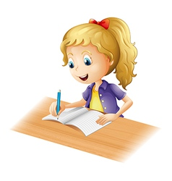
A huge well done to…
Kara S
For entering the Young writers competition over lockdown and having their work published in the Young Writers’ book.
An amazing achievement!

Slide 7
A huge well done to…
Elsie-Rae
For entering the Young writers competition over lockdown and having their work published in the Young Writers’ book.
An amazing achievement!

Slide 8
A huge well done to…
Amira
For entering the Young writers competition over lockdown and having their work published in the Young Writers’ book.
An amazing achievement!

Slide 9
Ash
Clara
Making a pancake homework and being super brave!
Mrs Laffan 26.3.2021

Slide 10
Oak
Nikola
Super writing about the lifecycle of a frog.
Mrs Laffan 26.3.21

Slide 11
Birch
Betsy W
This week Betsy has tried extremely hard with her writing. She has written a retell of the traditional tale Hansel and Gretel. Betsy included fantastic story language and tried hard to keep her handwriting small and neat. Well done Betsy!
Miss Hewitt 26.3.21.

Slide 12
Pine
Daniel
For working so hard at home and at school to learn the weekly spellings. Daniel has been practising in his word book.
Mrs Leedham-Hawkes 26.3.21.

Slide 13
Elm
Idris S
For a super retell of the traditional tale ‘Hansel and Gretel’. Beautifully neat with a lovely sequence of sentences. Well done Idris, you’ve shown lots of passion!
Miss Brady 26.3.21

Slide 14
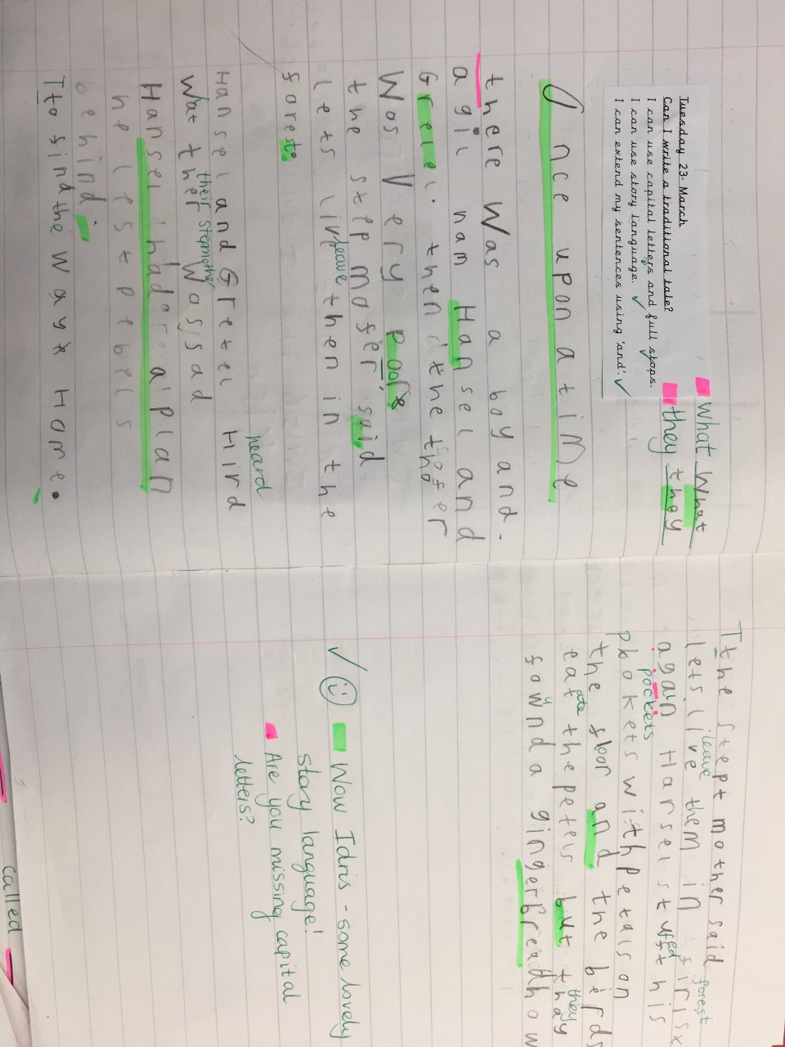
Idris’ amazing wow work!

Slide 15
Willow
Esme
Wow, what a great Canopic Jar you
have created! You took so much time
and patience to create this wonderful
sculpture. Well Done :)
Mrs Read and Miss Higgins 26.3.21.

Slide 16
Maple
Max W.
For fantastic concentration when creating a clay canopic jar and helping others when needed. Well done Max.
Miss Dawson 26.03.2021.

Slide 17
Spruce
Natalia
For always persevering in everything she does. This was especially the case this week in both maths and English. I was very impressed with her efforts and for seeking support when wanting to improve her understanding. Well done!
Mr Tennuci 26.3.21.

Slide 18
Chestnut
Liam
For his fantastic knowledge in Science. He showed excellence when sharing his own knowledge and understanding and supported others. Well Done Liam!
Miss Fisher 26.3.21.

Slide 19
Aspen School
Wow Learner
Sophia
For her superb writing choices this week. Sophia has shown passion and excellence within all of her writing.
Mrs Davies 26.3.21.

Slide 20
Redwood
Lewis G
For showing true resilience and teamwork during the CoJo experience. Keep up the amazing work and enjoying being part of team!
Miss Shipley 25.03.21.

